Slide 1

STOCK LENS ~Unveiling Corporate Dynamics
Team members:
Peter Ly (5502)
Vijay Kumar Poloju (5502)
Andrew Connell (4502)
Harrison Fagan (4502)
Note: Some images in this presentation may be generated by artificial intelligence.

Slide 2
Introduction
Focus
Data mining and analysis using SEC reports and stock market trends of the company
Key technologies
Natural Language Processing (NLP), Machine Learning, and Statistical Analysis
Objective
Analyze company decisions, hidden partnerships, and stock prices
Notes:
Good [morning/afternoon], everyone! Today, I’m excited to present "StockLens," our data mining project focused on uncovering insights from company earnings reports using Natural Language Processing (NLP) and advanced statistical analysis.
In the world of finance, companies release earnings reports each year, which can significantly impact their stock prices. Our project aims to analyze these reports to understand how specific business decisions influence stock movements. By applying NLP, we extract key insights from the language used in these reports, identifying patterns and trends that might not be immediately obvious.
But we’re not stopping there. We also investigate potential correlations between companies. By comparing their earnings reports and financial movements, we aim to detect abnormal correlations that might signal hidden partnerships or collaborations between organizations.
Our approach includes both time-series analysis and predictive modeling to give a comprehensive view of corporate behavior. With this project, we hope to shine a light on how companies shape the stock market and offer new ways to understand their interrelations.

Slide 3

Goals
Explore correlations between companies to identify potential partnerships
Provide predictive insights for future stock movements
Identify patterns and trends across multiple companies
Understand the impact of business decisions on stock performance

Slide 4
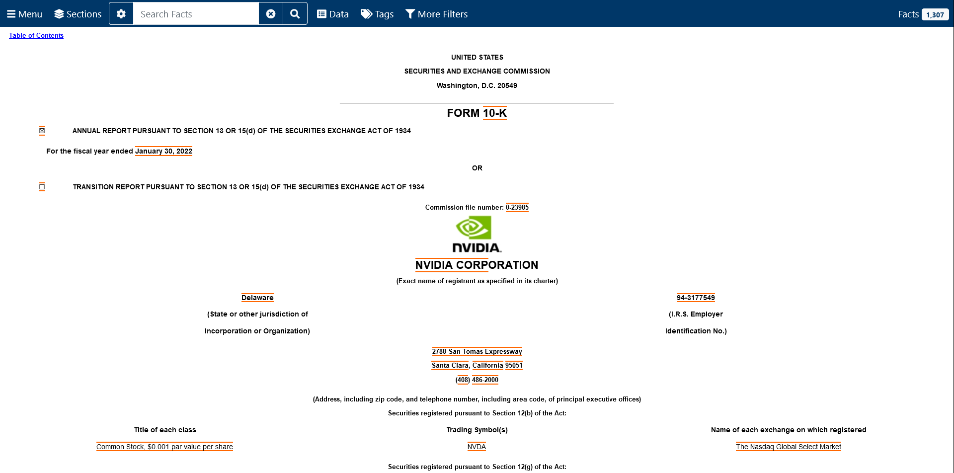
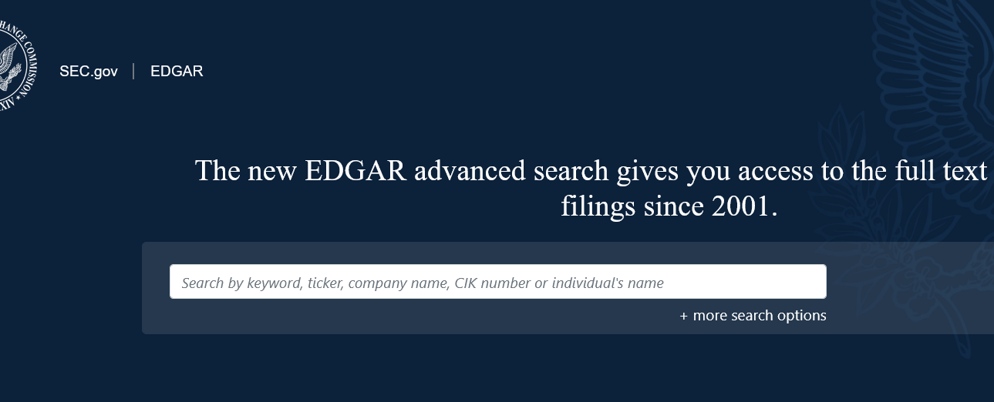
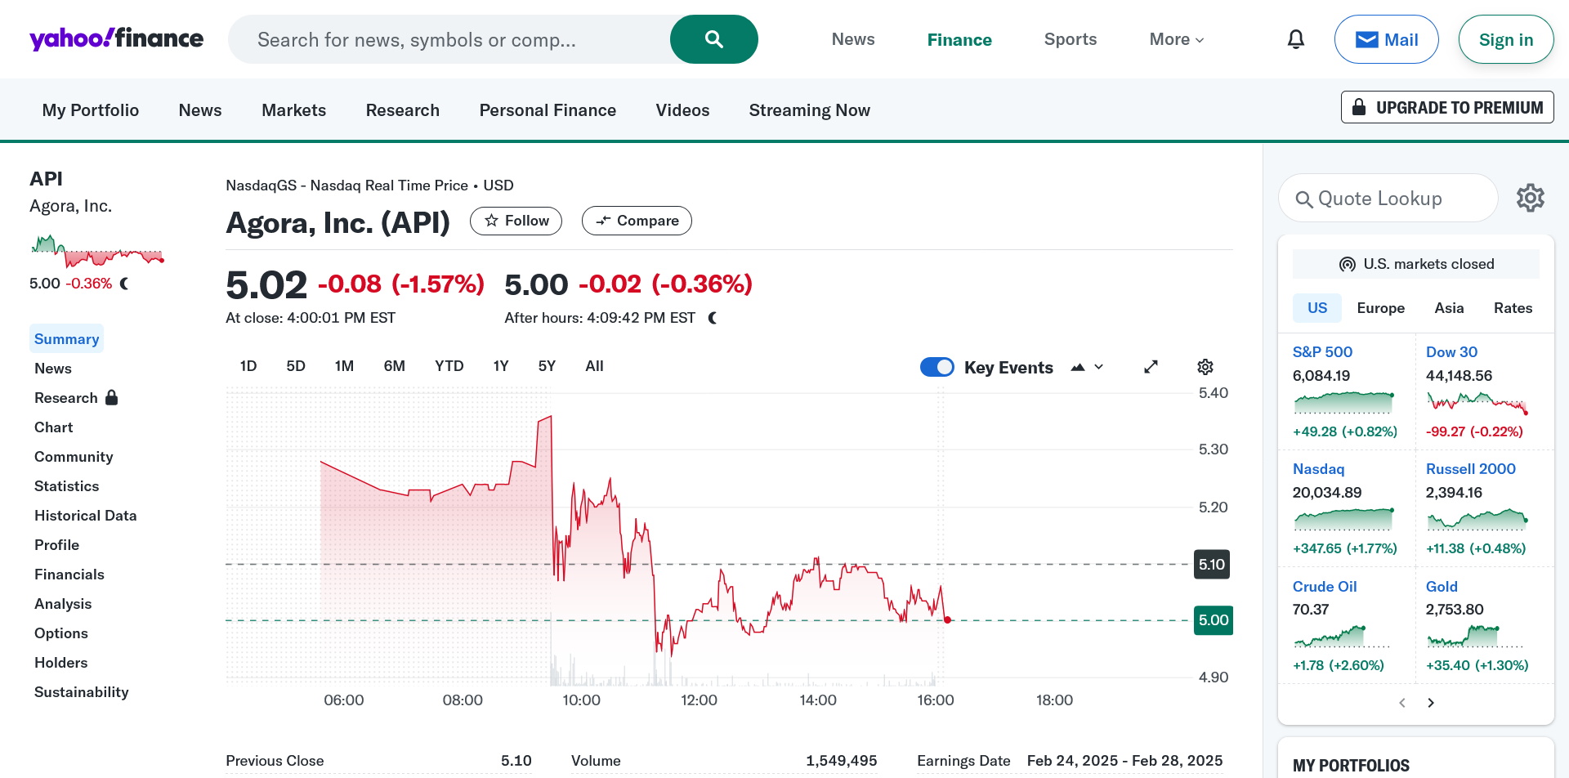
Data Sources
SEC public filings
10-K reports
https://www.sec.gov/edgar/search/
Quaterly reports TSV files (around 25 GB)
Stock prices
yFinance (API)
https://pypi.org/project/yfinance/

Slide 5
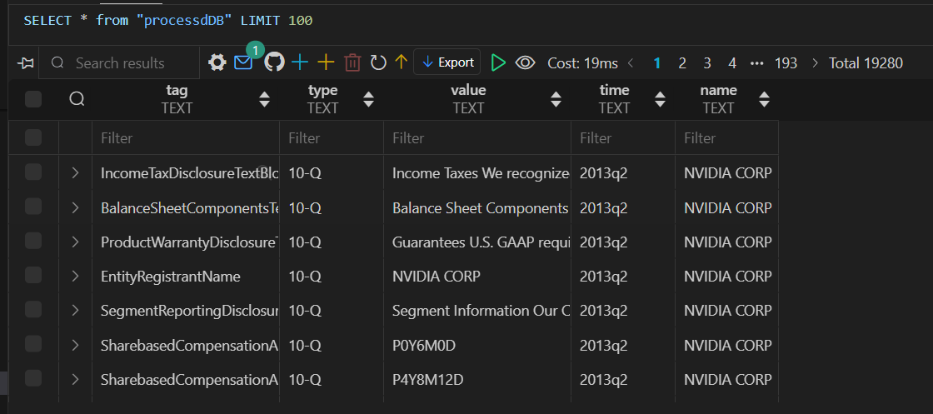
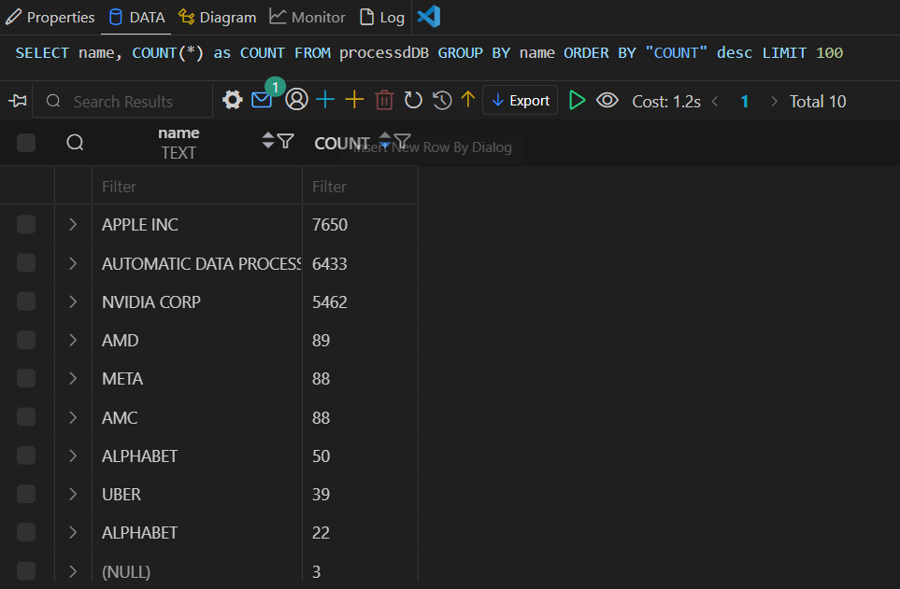
Data management
Relational Database with extracted key value pairs that’s been processed.
ID
primary unique key
Tag
key
Type
type of report 10-Q or 8K or 10-K
Value
value of key
Time
report time
Name
Company Name
Business
Business Direction
RF
Risk Factors
URFC
Unresolved Staff Comments
Cybersecurity
Security changes
Properties
Properties
MDAFC
Management's Discussion and Analysis of Financial Condition and Results of Operations
QQDMR
Quantitative and Qualitative Disclosures About Market Risk
FSSD
Financial Statements and Supplementary Data

Slide 6
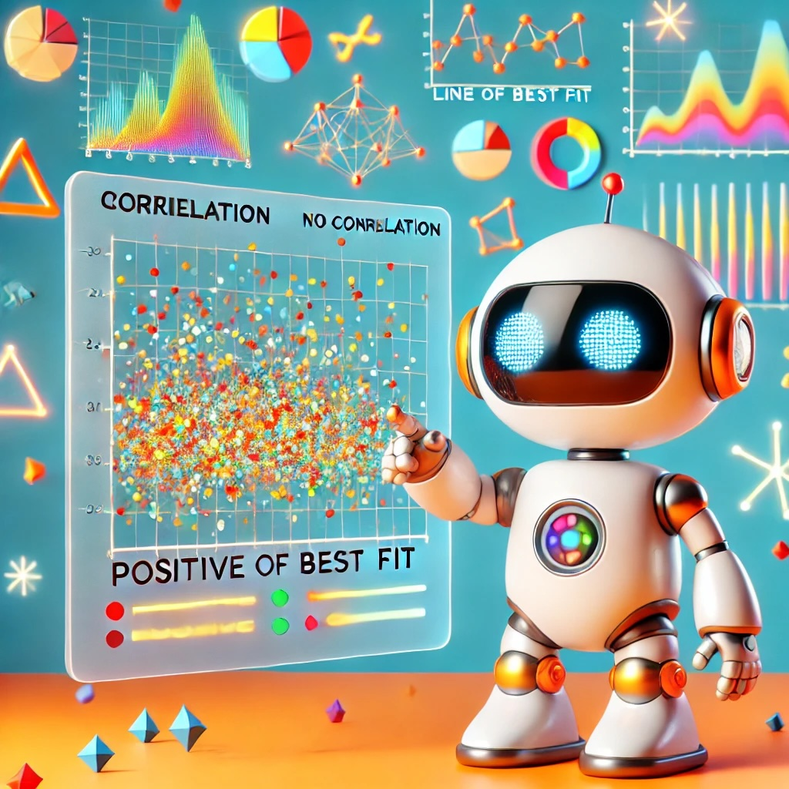
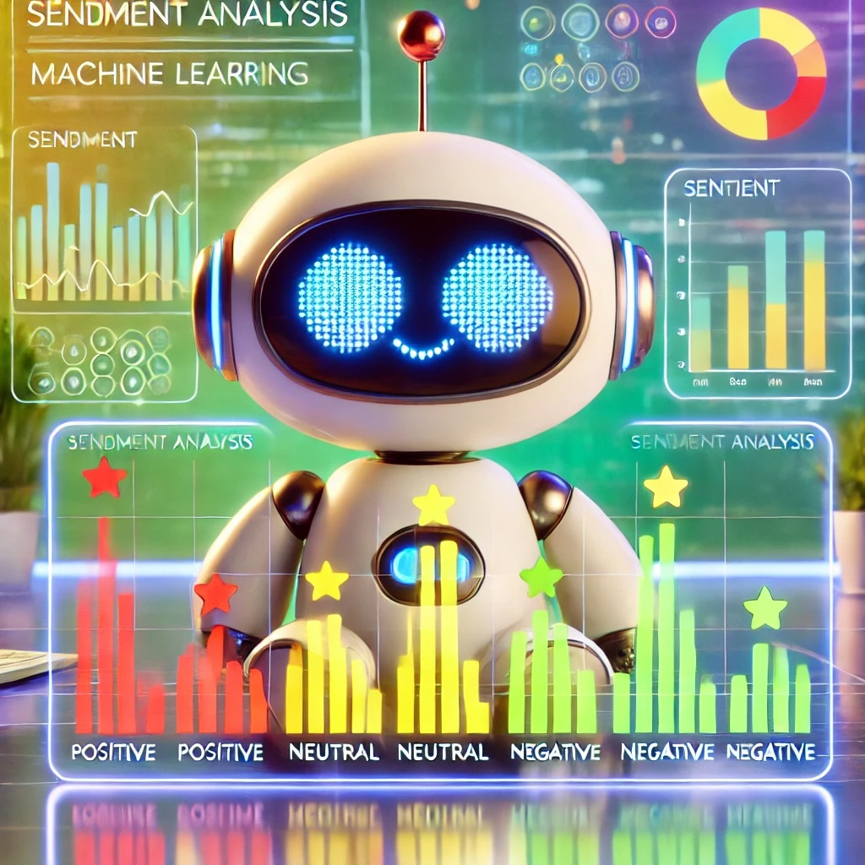
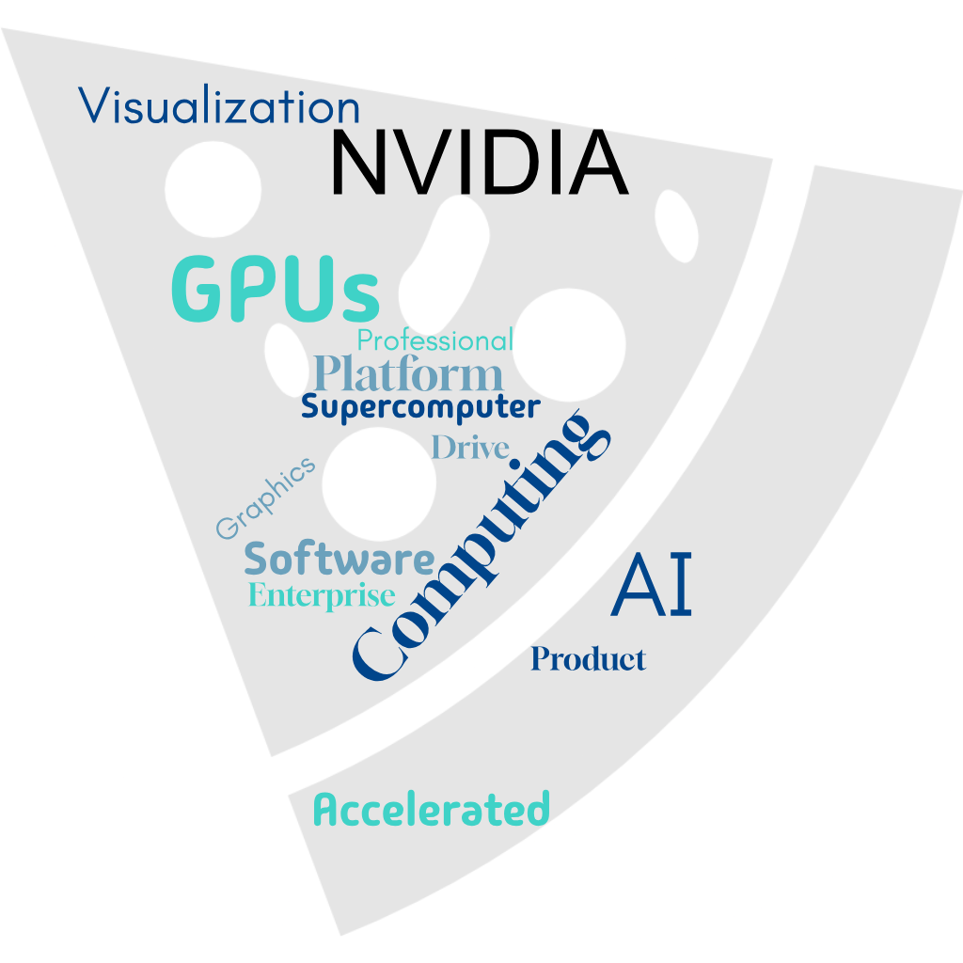
Data processing
10-K reports
Keyword analysis
Sentiment analysis
Stock prices
Correlation analysis

Slide 7

Insights

Slide 8
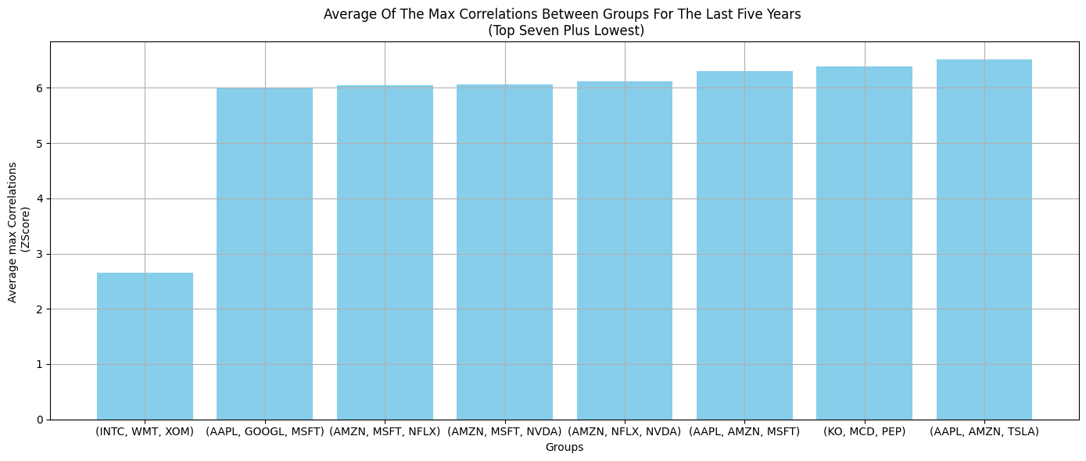
Correlation Insights
AAPL: Apple
AMZN: Amazon
GOOGL: Google
INTC: Intel
KO: Coca-Cola
MCD: McDonald's
MSFT: Microsoft
NFLX: Netflix
NVDA: Nvidia
PEP: Pepsi
TSLA: Tesla
WMT: Walmart
XOM: Exxon

Slide 9
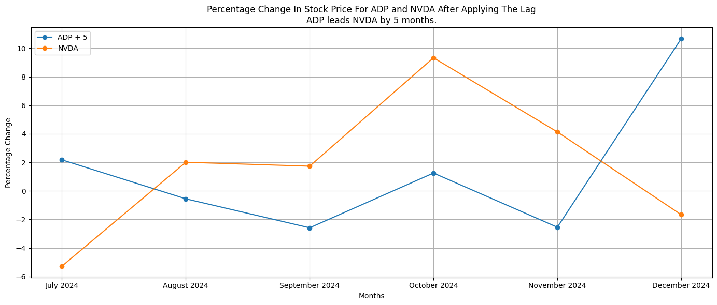
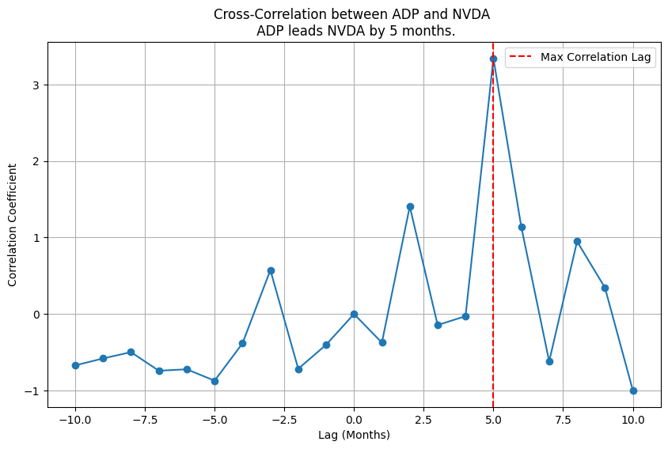
https://www.moomoo.com/news/post/45207411/amd-earnings-show-power-of-nvidia-software-adp-data-defies?level=2&data_ticket=a1f55cb7ca194eb87fb62f96c938d1d6

Slide 10
Predicting Prices with Sentiment
LSTM Block
Prediction Block
Next Day Prediction
Stock
Data
Sentiment Data

Slide 11
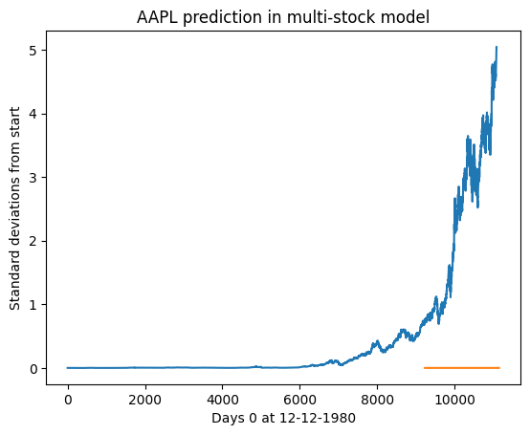

Slide 12
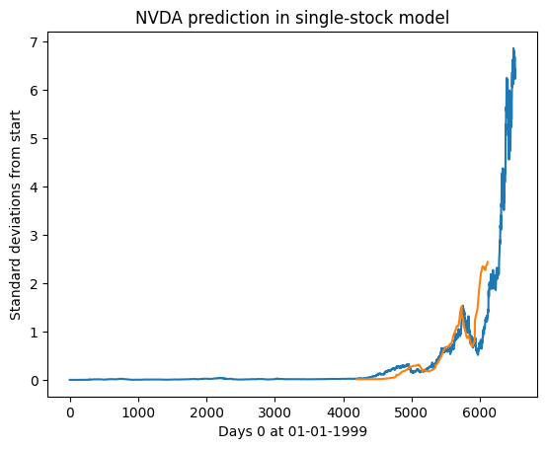
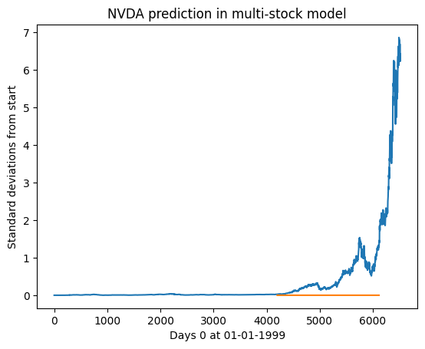

Slide 13
Clustering Companies by Keywords
Company keywords
Good number of clusters
Silhouette score
K-means
Clusters of companies
Word embedding
Words close to cluster centroid
Interpretations for clusters
Term frequency – Inverse document frequency
For presentation purposes, we then project the clusters into two dimensions using t-SNE

Slide 14
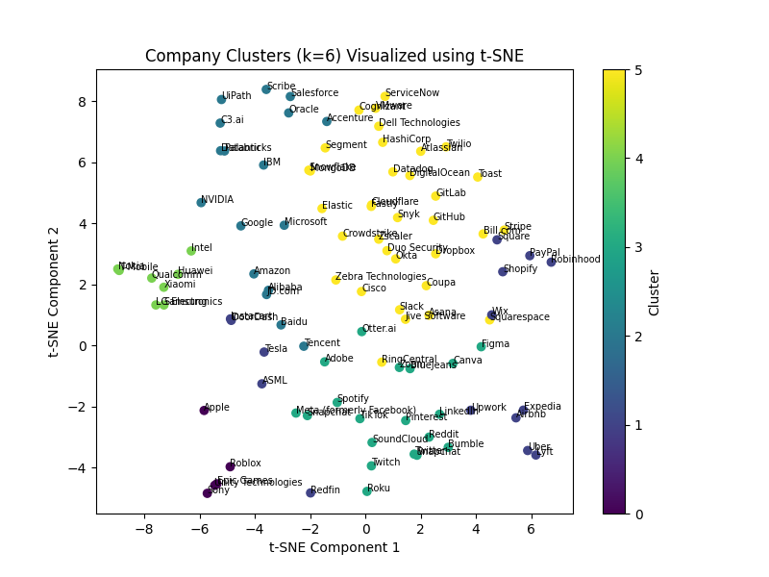
Clustering Companies by Keywords
Platform, Enterprise
IoT, Mobile
NVIDIA and Intel being separated is surprising
Marketing, Digital
Analytics, ML
Integration, Virtualization
VR, AR

Slide 15
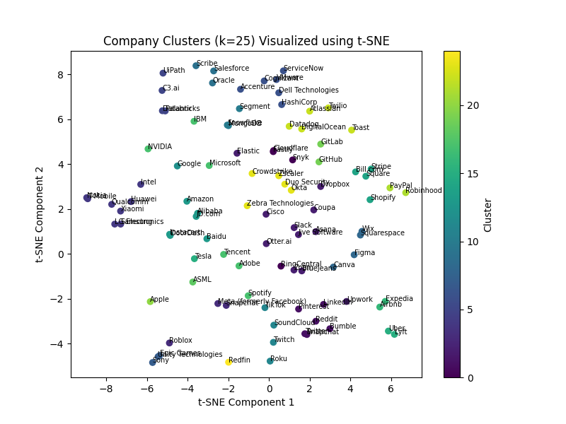
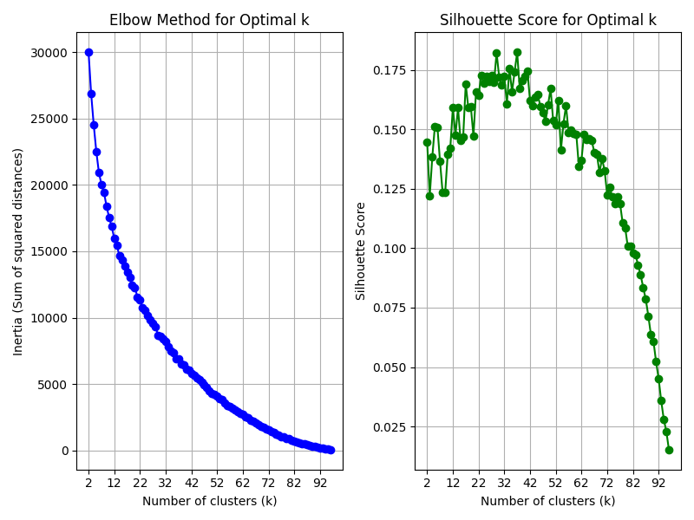
Clustering Companies by Keywords
Setting k to get a high silhouette score gives good interpretability of the clusters

Slide 16
Classifying Company Performance
Company keywords
Silhouette score
Optimum number of clusters
Keyword clustering
Decision tree
Company sentiment
Words close to cluster centroid
Interpretations for clusters
Hyperparameter tuning (depth, number of clusters)

Slide 17
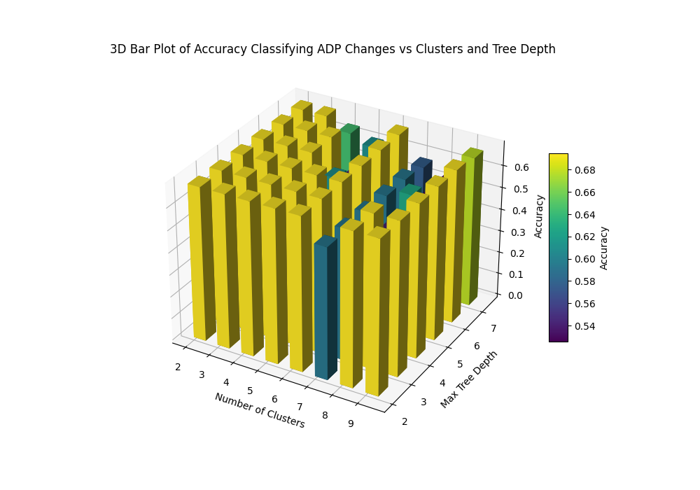
Classifying Company Performance
We computed the cross-validation accuracy of the decision tree under several choices of hyperparameters

Slide 18
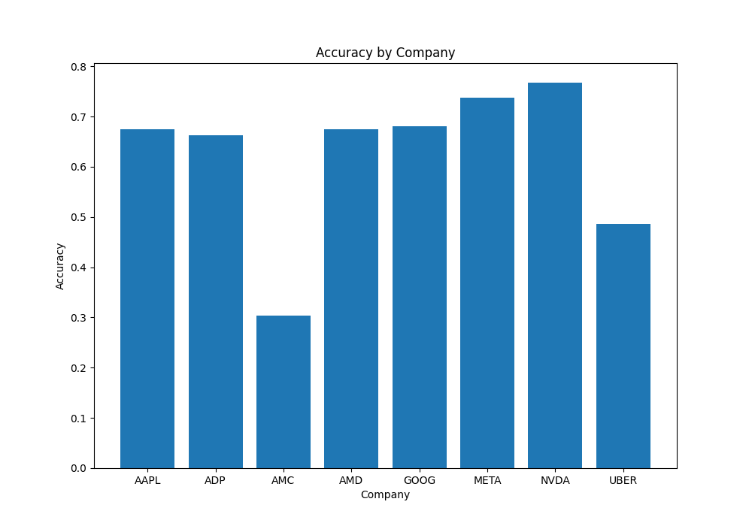
Classifying company performance
Surprising that our model has high accuracy ADP (Automated Data Processing)
Model does very well for tech companies because clusters were focused more on tech company directions
AMC: AMC Entertainment Holdings
META: Meta Platforms
UBER: Uber

Slide 19

Discussion

Slide 20
Complications In Our Analysis
Dataset Limitations
Difficulty in confirming existing partnerships
Limited data for certain companies or industries
10-K reports are hard to extract draw succinct information
Accuracy in Correlations
Distinguish correlation from causation
Handle industry-specific trends that may skew results
Clusterings of companies do not indicate that the companies are collaborating
Hard to find a balance between number of clusters and ease-of-interpretation for clusters

Slide 21
Discussion and Future work
Using yFinance recent articles regarding companies to get updated
Better parsing for 10-K report
Instead of yearly and monthly data, use daily data
Accounting for overall market performance
Use an a priori algorithm to group companies using max correlation
Thank you

